Slide 1



Slide 2
pLED 2014
Ha Noi, April 26th

Slide 3
Introduction Team
pLED Team
1
Nguyễn Thanh Tùng : PM, Designer, Tester
2
Nguyễn Thế Long: Technical Leader, Developer
Đỗ Văn Ban: Mechanic, Tester
Đinh Xuân Bách: QA, Test Leader
Đinh Quang Hải: Developer, Designer

Slide 4
Contents
1
1
Introduction
5
Implementation
2
2
6
Testing and Quality Assurance
Management Plan
3
Requirement
Specifications
7
Demo
4
Conclusion and Q&A
Design
8

Slide 5
Introduction
Persistent of Vision : The phenomenon of the eye by which an after-image is thought to persist for approximately one twenty-fifth of a second on the retina, create a illusion of existing object when there was none.

Slide 6
Introduction
Idea Base on Persistence of Vision phenomenon, we have made a device that can create a clock, a picture, a animation screen in front of audiences. The purpose of this device is to pure entertainment and amaze anyone have seen it the first time. Also this provide a opportunity for team member to be more proficiency in Embedded System field.

Slide 7
Introduction
Scope
System will:
Display 4 modes
Remote control using radio frequency
Display Real – Time Clock (GMT + 7)
Store data and require one-time setup only
Run stable in 2 hours

Slide 8
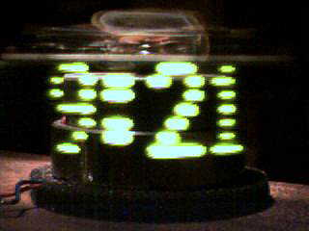
Introduction
Existed product : “Bob Blick‘s propeller clock”

Slide 9
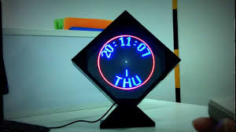
Introduction
Existed product : “AVClock”

Slide 10
Management Plan
Software Process Model: Iterative and Increment Development (IID)
Delivery : 17/4/2014
Efforts : 5 mem/month
Duration : 3 months
Budget: 121 million VND ☺

Slide 11
Management Plan
Risk Management
No experiences design hardware
Uncontrollable outsourcing
Limited physical components
Less experiences estimate time and resource

Slide 12
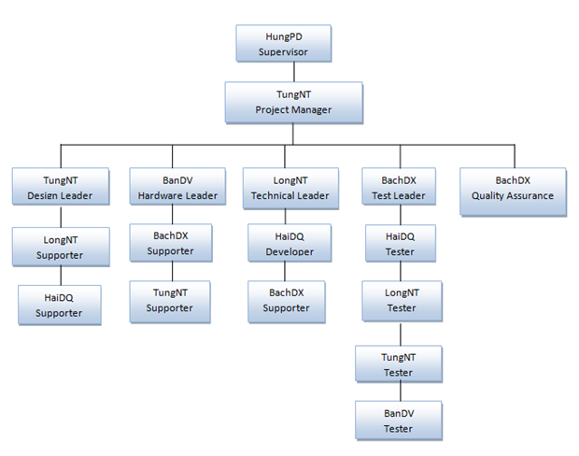
Management Plan
Role and Responsibilities

Slide 13
Management Plan
Configuration Management
Using google code : https://pled.googlecode.com/svn/
Document and file must be save on right folder SVN
Version of document must be increase if it was changed
When commit file and document into SVN member must be write comment or message

Slide 14
Requirement Specifications
User Requirements
User
Real – Time Clock
Decorating
Student
System demo when learn Embedded System

Slide 15
Requirement Specifications
System Specification
Using PIC chip to control the system
Display image, clock and animation in multicolor
System can be controlled with radio remote
One-time setup with real-time clock built-in
Array of RGB LEDs used to create visual
Work with Vietnam’s household electrical standard(220v AC)

Slide 16
Requirement Specifications
Functional
Display digital clock
Display analog clock
Display image
Display text
Setup time

Slide 17
Requirement Specifications
Non - Functional
System stable
Picture display smoothly
User can use product after 5 minutes when they read guideline
Safety
Avoid electric shock- proof

Slide 18
Requirement Specifications
Infrastructure and Tools
Hardware
PIC16F887
DS1307
EEPROM
LED RGB
Radio Frequency Module
Shift Register
IC 7805
Motor

Slide 19
Requirement Specifications
Infrastructure and Tools
Software
IDE CCS C 5.015
ISIS Protues
Pickit 2, ICD2 Program
Visual Studio 2012 vs .NET 4.0
Altium Designer 10
Electronic multi-meter

Slide 20
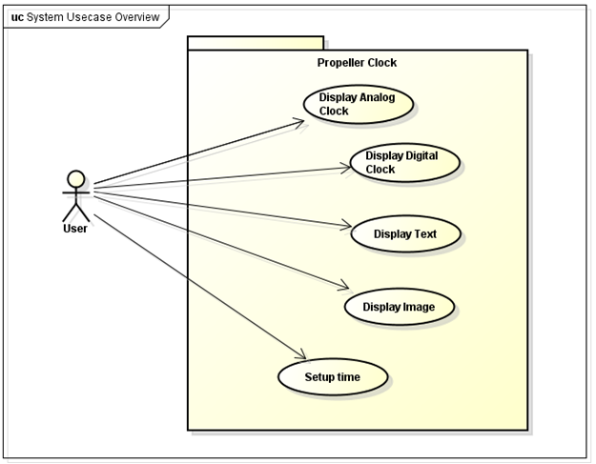
Design
Architecture Design
Use case

Slide 21
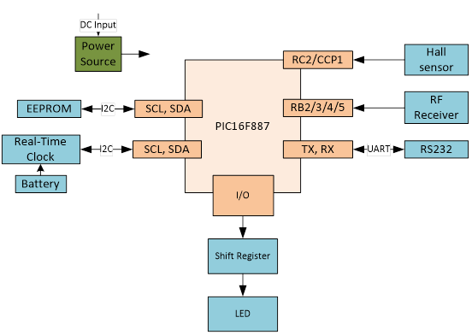
Design
Architecture Design
Block Diagram

Slide 22
Design
Mechanical
Supply power for main board using Rolling-element bearing

Slide 23
Design
Mechanical
VCC
VCC
Motor
Bearing
Shaft
Plastic

Slide 24
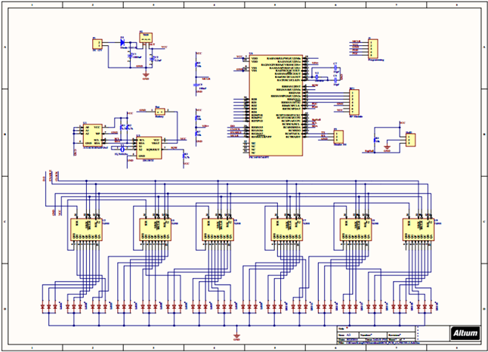
Design
Schematic, PCB Design

Slide 25
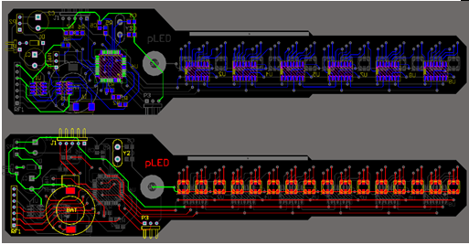
Design
Printed Circuit Design

Slide 26
Design
Display Mode
MODE_A: Analog Clock
MODE_B: Digital Clock
MODE_C: still image
MODE_D: running text

Slide 27
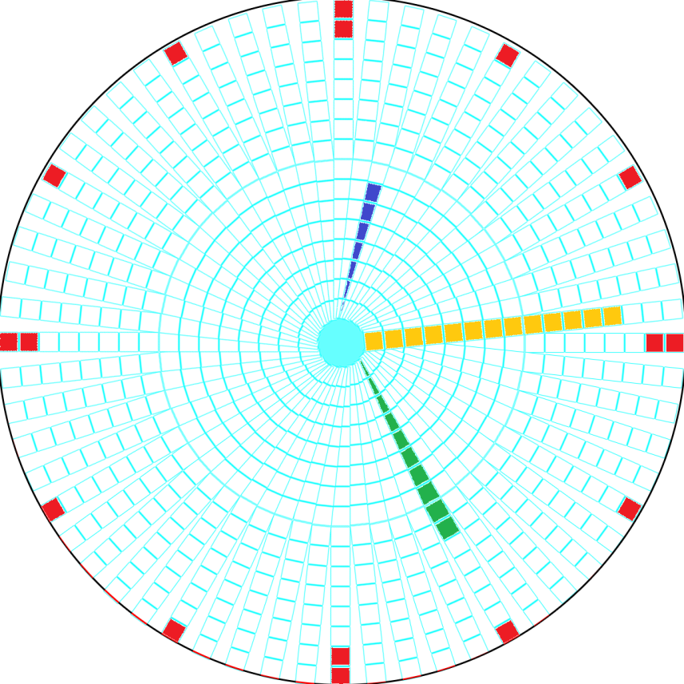
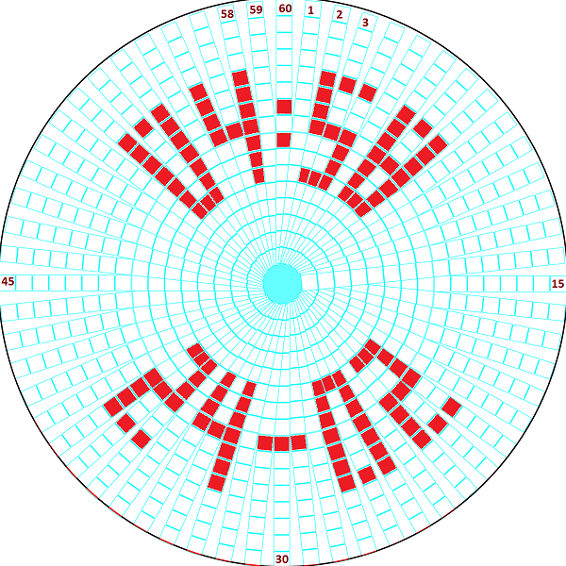
Design
Screen 16 LEDs x 60 NODEs

Slide 28
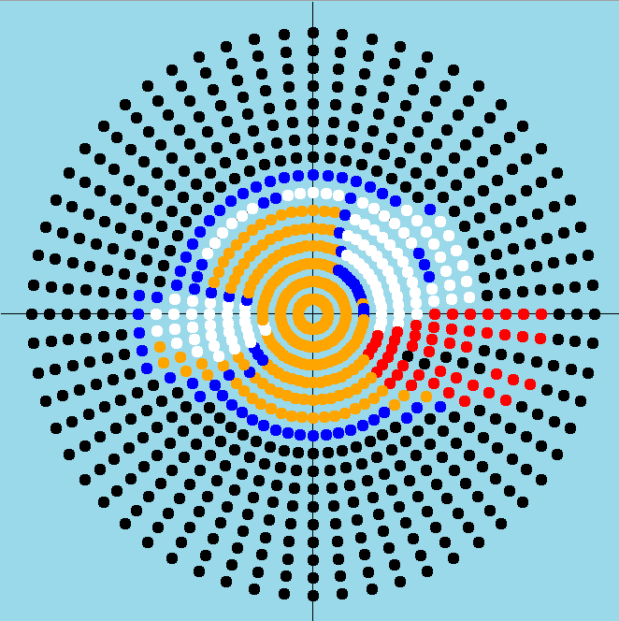

Slide 29
Design
LED’s data structure INT16[3]
 | BYTE 1 |  |  |  |  |  |  |  | BYTE 0
 | 7 | 6 | 5 | 4 | 3 | 2 | 1 | 0 | 7 | 6 | 5 | 4 | 3 | 2 | 1 | 0
 | LED1 | LED2 | LED3 | LED4 | LED5 | LED6 | LED7 | LED8 | LED9 | LED10 | LED11 | LED12 | LED13 | LED14 | LED15 | LED16
rgb_bits.blue
rgb_bits.red
rgb_bits.green

Slide 30
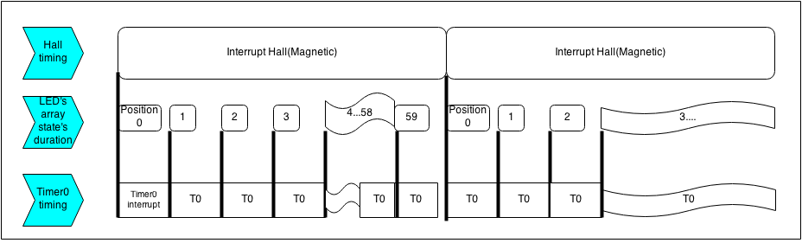
Design
Timing algorithm
The system use 2 interrupts to acknowledge when a new rotation started and when to print out the next Position’s data of LEDs array.
Each Hall interruption indicates when the array LED has finished a rotation.

Slide 31
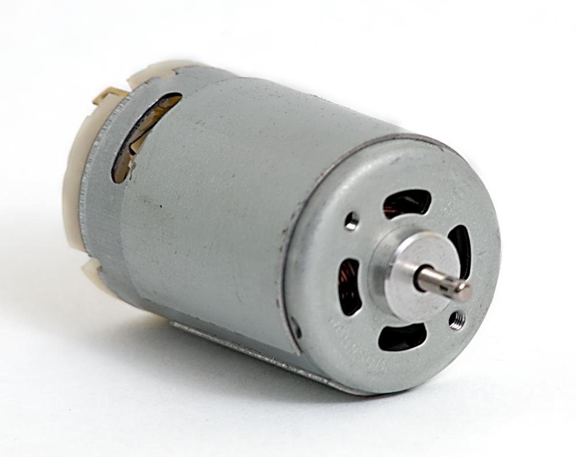
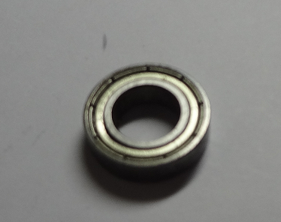
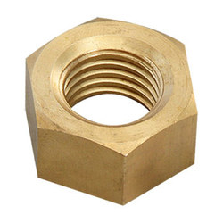
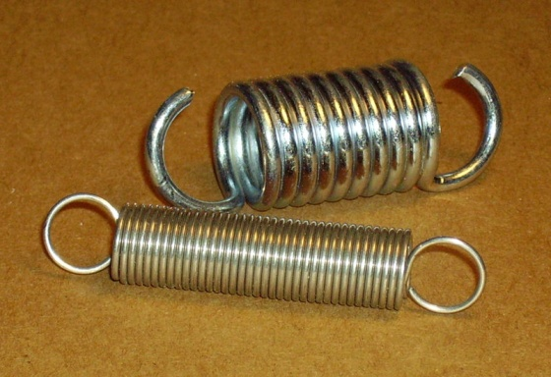
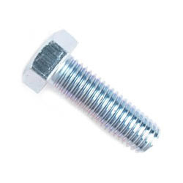
Implementation
Mechanical
Nut and bolt
Rolling-element bearing
Motor
Spring

Slide 32
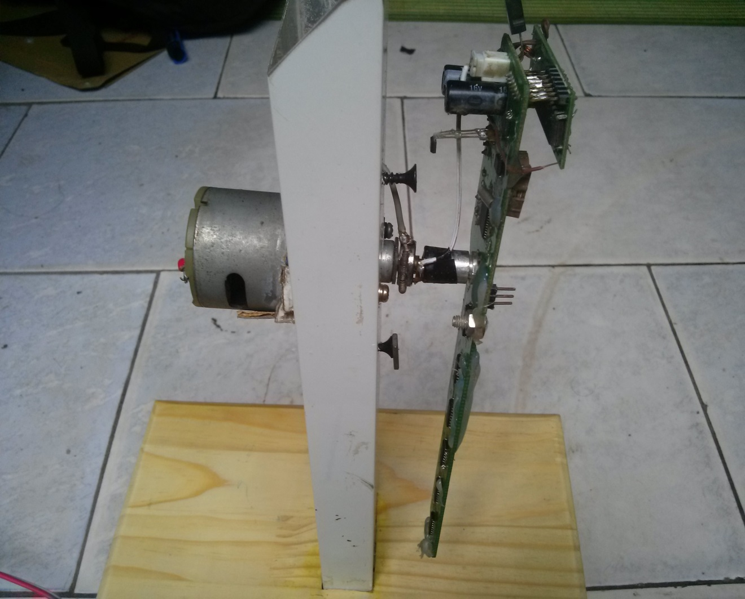
Implementation
Mechanical

Slide 33
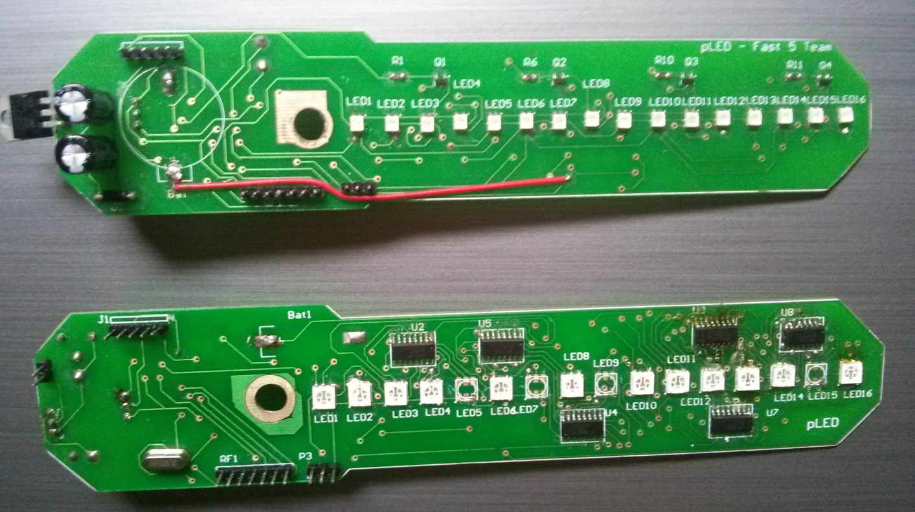
Implementation
Circuit Board
pLed dual and triple color v1.0 (legacy)

Slide 34
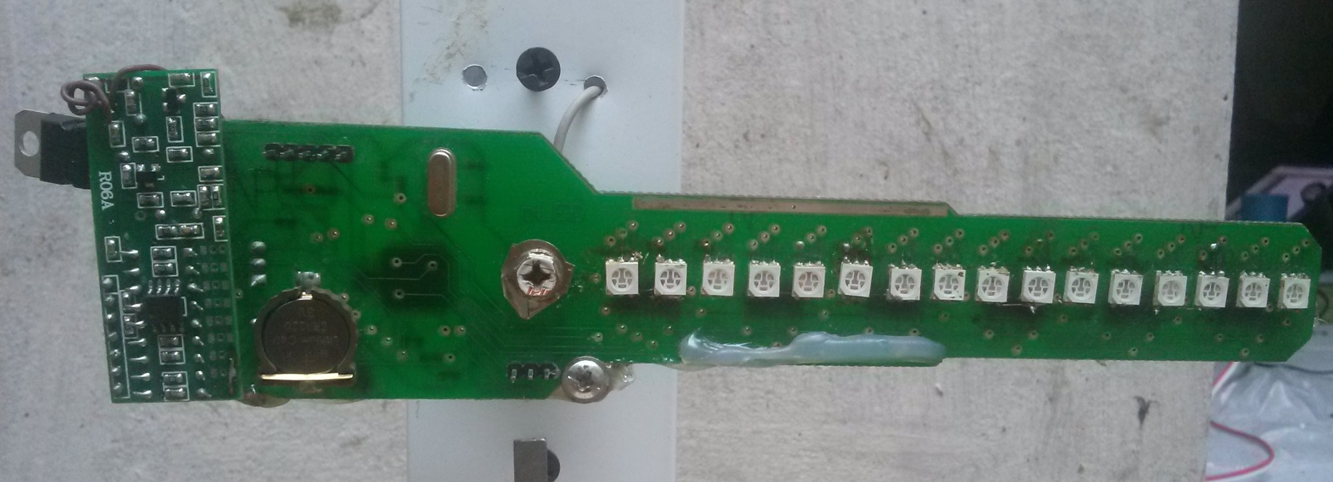
Implementation
Circuit Board
pLed triple color v2.0

Slide 35
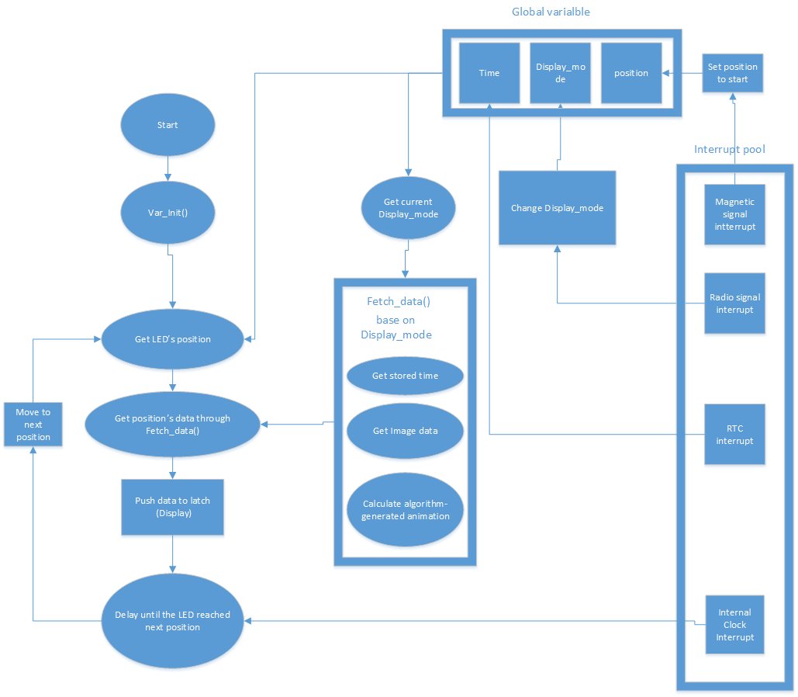
Implementation
System structure

Slide 36
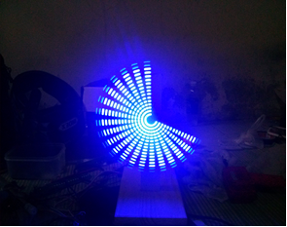
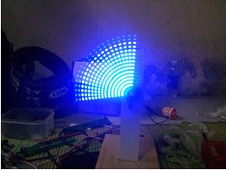
Implementation
Modify Driver: performance
Before optimization
40 state changes take 7/10 rotation
After Optimization
40 state changes take 3/10 rotation

Slide 37
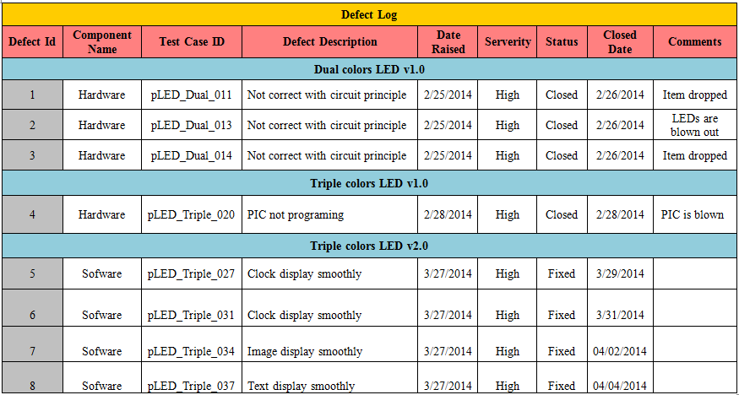
Testing &QA
Defect Log

Slide 38
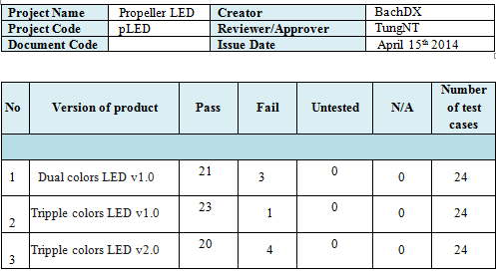
Testing &QA
Test Report

Slide 39
Testing &QA
Quality Assurance
4 bugs after release
4 bugs into 1 issue

Slide 40
Lesson learnt
Obstacles
Solution
Limited hardware option
Processing power is a lot lower than expected
Soldering quality is low
Inexperienced in estimate time schedule
Re-inspect the market and buy extra amount if possible
Optimize driver and using multiple backup algorithms
Manually checking circuit board’s completion and self-learn soldering
Asking for supervisor suggestion

Slide 41
Suggested improvement
Using higher performance controller, 16bits chip is recommended
Develop team’s own soldering staff for easier maintain and customization
Use popular components for easier acquire, replacing ,and better community’s support.
Frequently asking for professional opinion to avoid rookie mistakes.

Slide 42
Thank You !

Slide 43
Question and Answer

